Slide 1
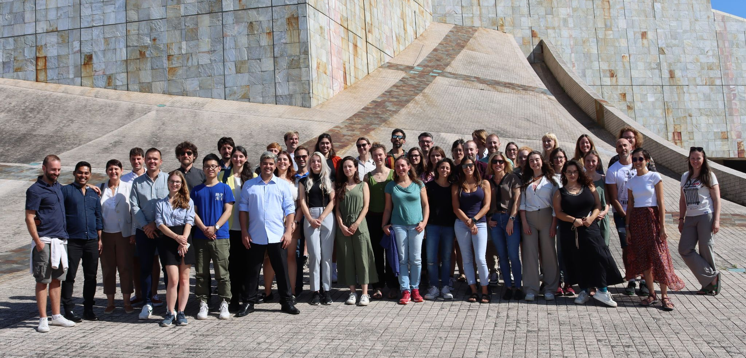
The EMB ECOP Network

Slide 2
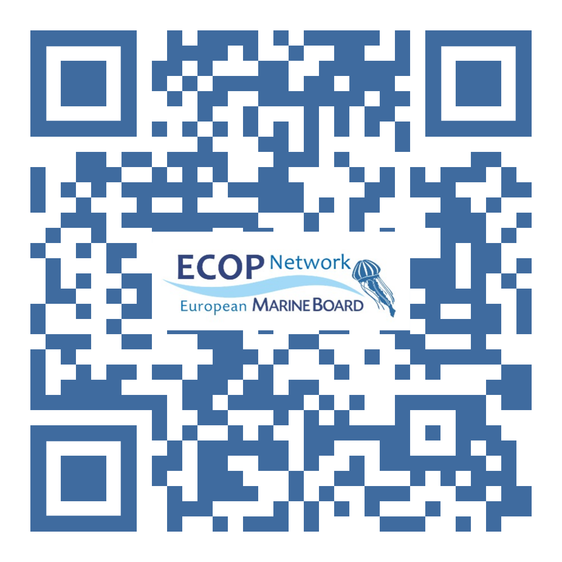
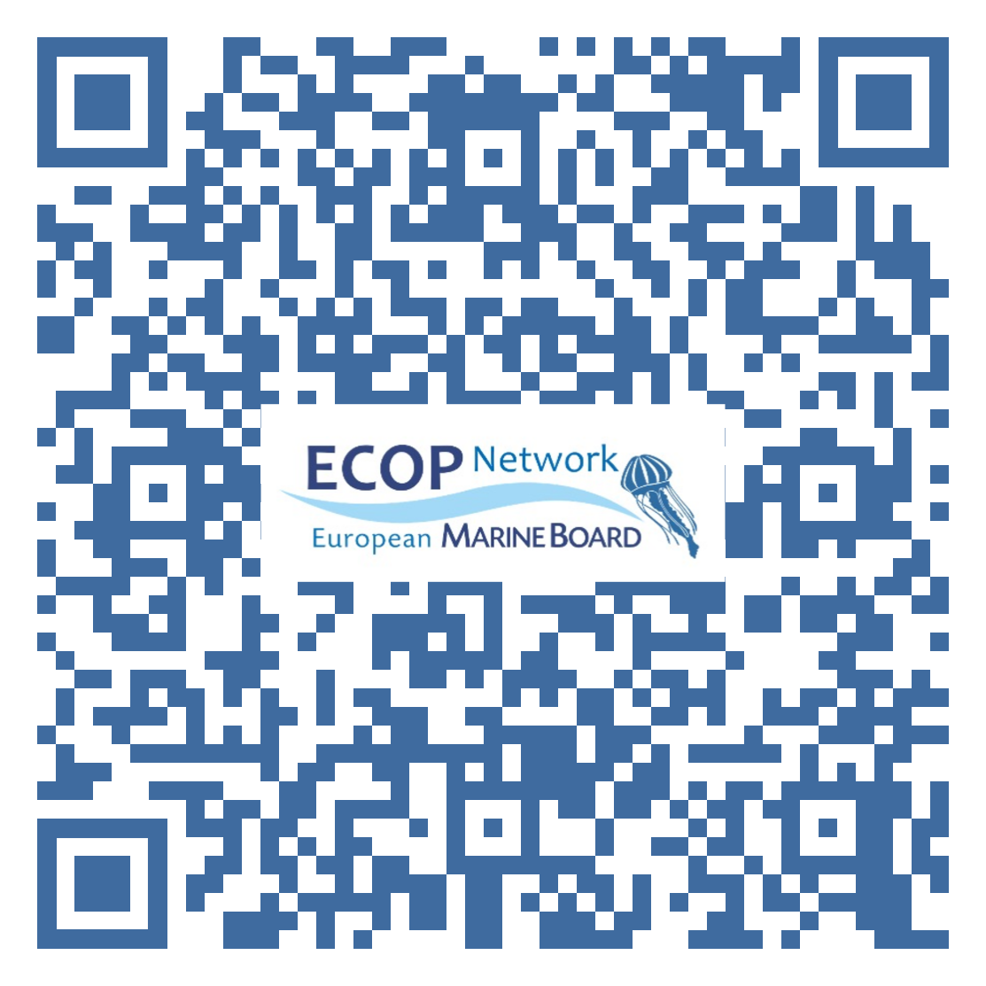
The EMB ECOP Network
Our missions
Training: linking marine sciences and policies
Networking: across organizations and Europe
Engaging and gaining a voice: at EMB and EU level
Our activities
First ECOP Forum: training and recommendations with 38 ECOPs
ECOP Wednesdays series
“Meet our ECOPs”: short introductions on social media
Participation in EMB activities
Engage with us to shape the Network!
Twitter: @EcopsEmb
LinkedIn: ECOPs Network European Marine Board

Slide 3
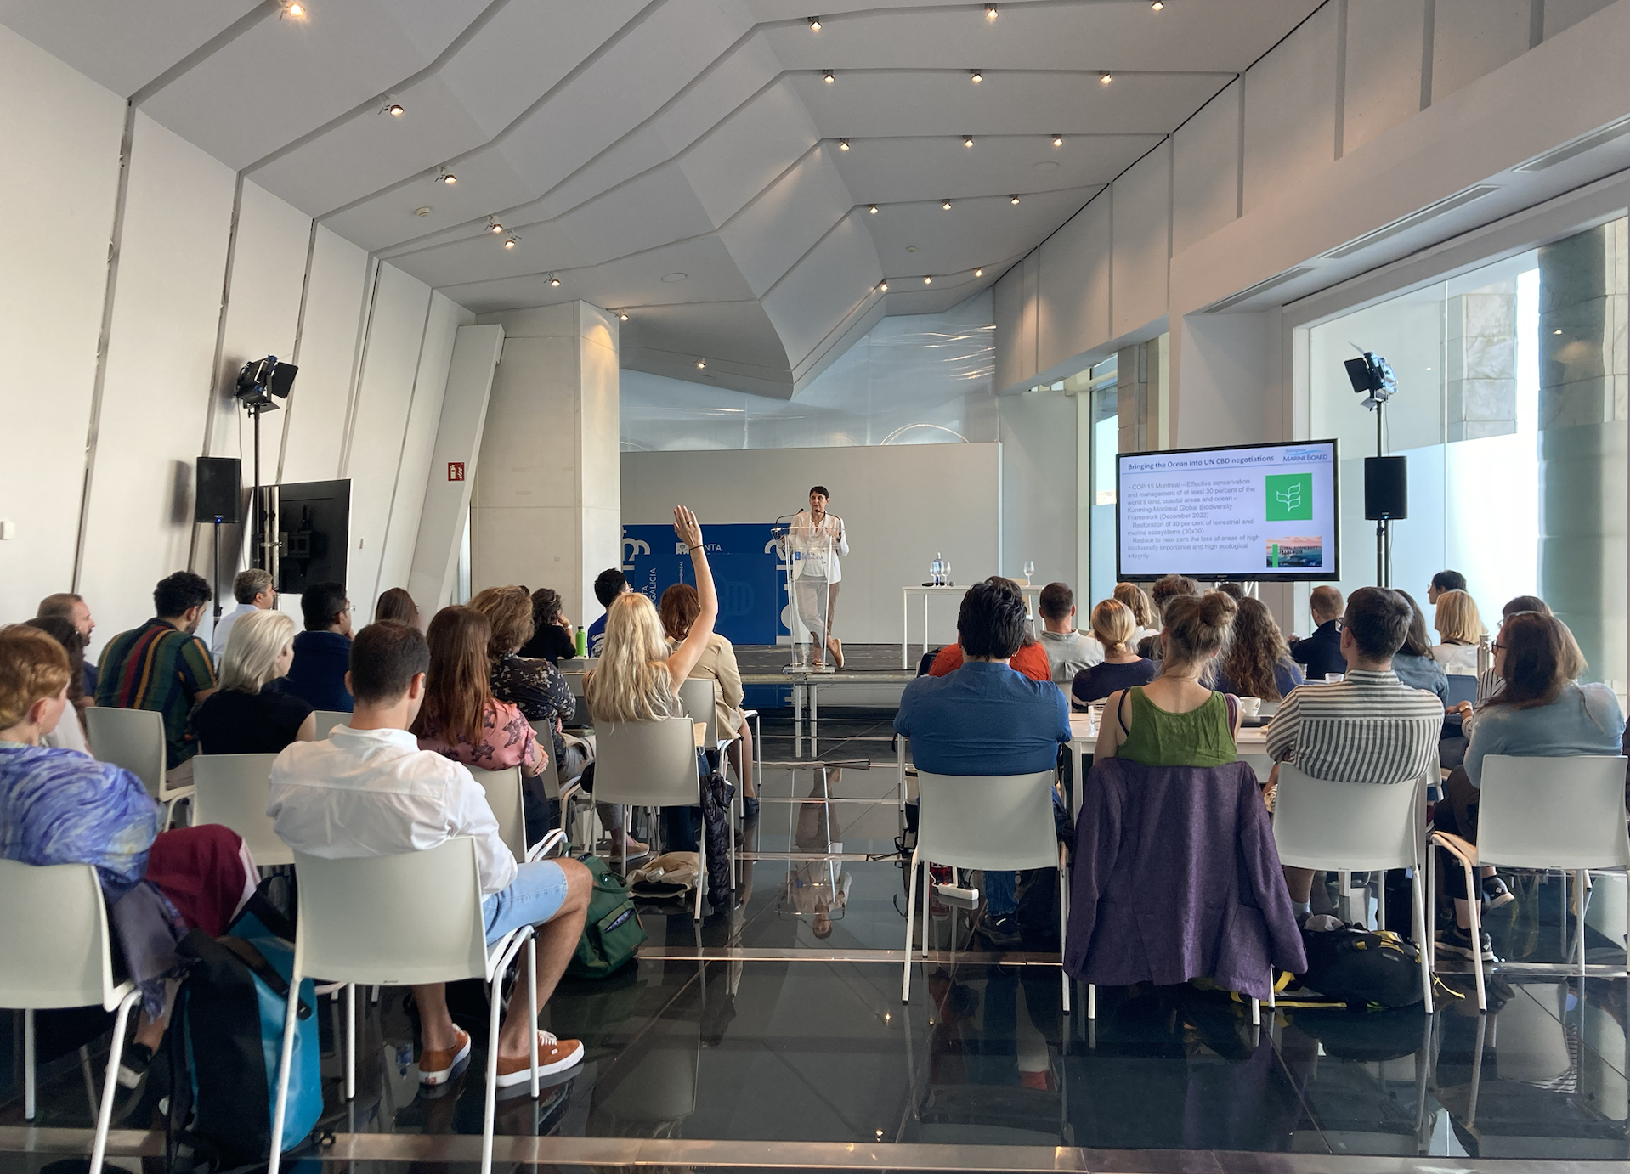
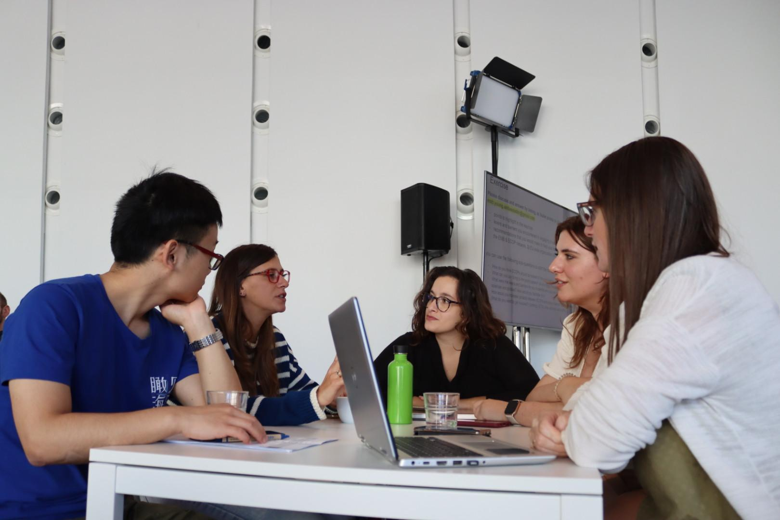
ECOP Network Forum
1st Network forum 8-9 October in Santiago de Compostela
38 ECOPs from 25 member organizations
Introduction to the EMB and Science-policy landscape
Brainstorming session about networking needs
Training session in effective communication
Notes:
Forum outcomes will be summarized in final report and distributed among member organizations

Slide 4
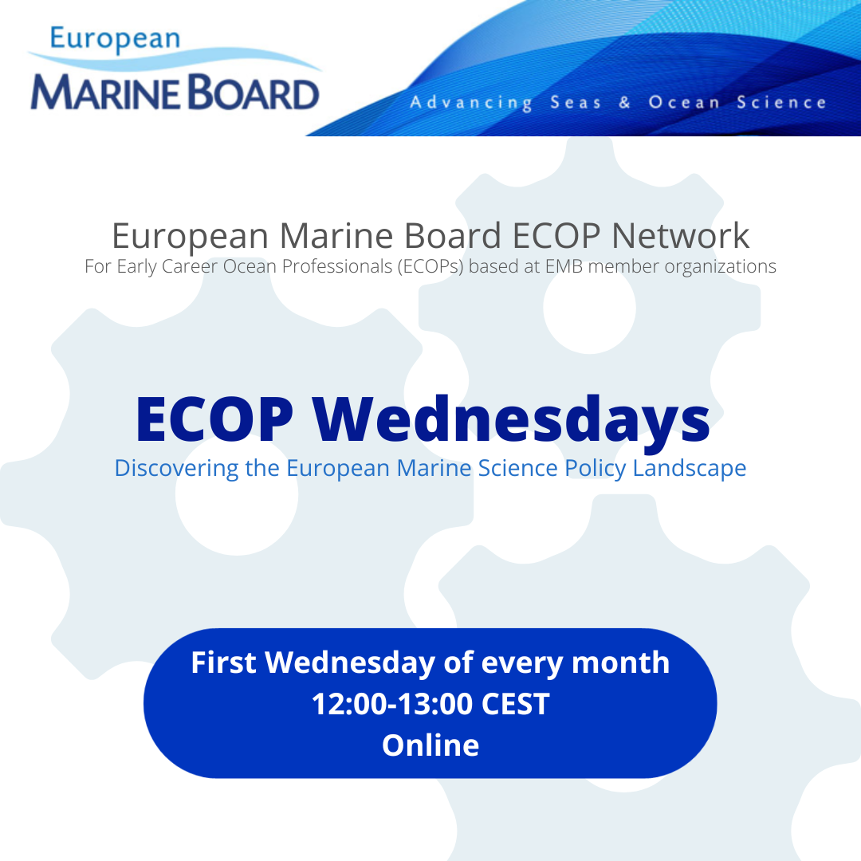
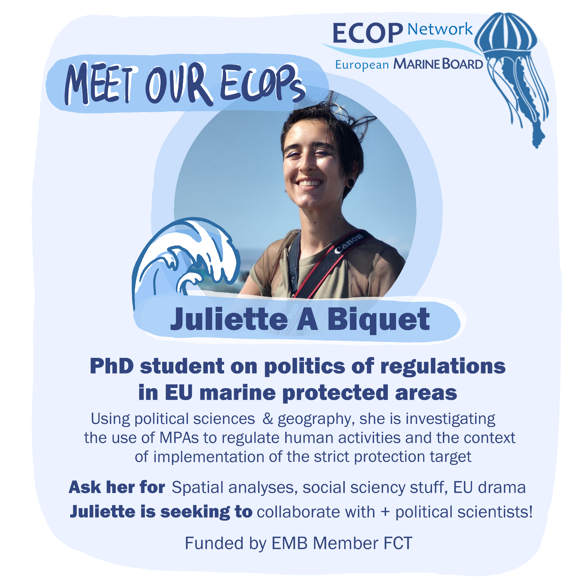
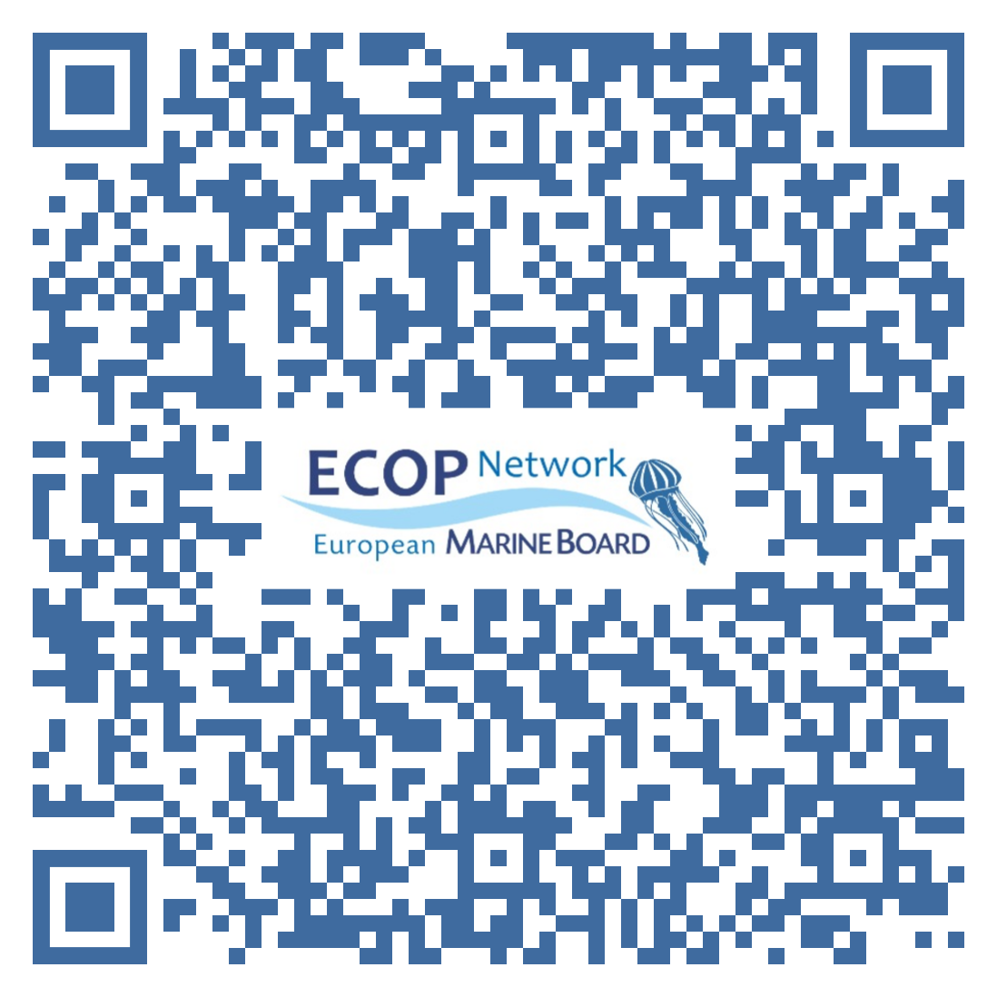
ECOP Wednesdays & “Meet Our ECOPs”
ECOP Wednesdays
Monthly webinar
Topics focus on European and international marine science-policy interfaces
You can suggest speakers or speak yourself
“Meet Our ECOPs”
Short introductions of network members on social media and EMB website
Highlighting their expertise and interests

Slide 5
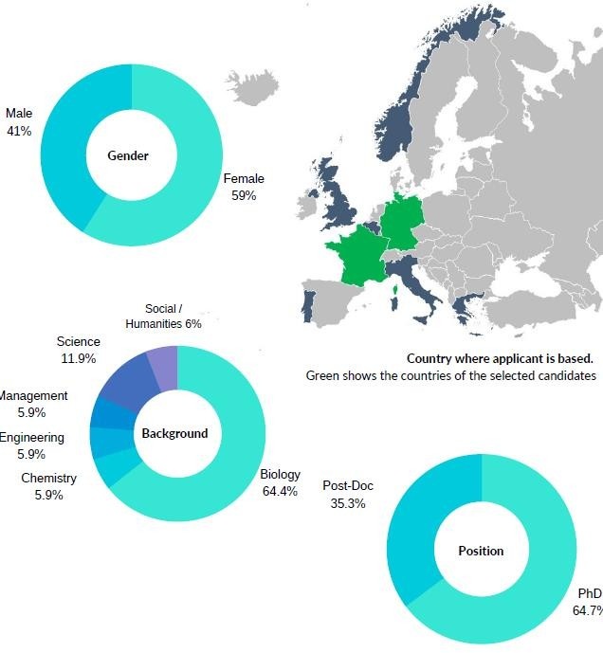
EMB Young Ambassadors
Ambassador Activities
Participate in EMB activities
Represent early careers at board meetings
Manage the EMB ECOP Network
Spread the word about the work of the EMB (by giving talks, writing blogs, etc.)
Why applying?
Get involved in a large European marine science network
Increase ECOPs representation
Your activities are funded + 2,000€ grant over the 2 years
Call for Ambassadors open in February 2024
Notes:
4 current Ambassadors (2 selected each year)

Slide 6
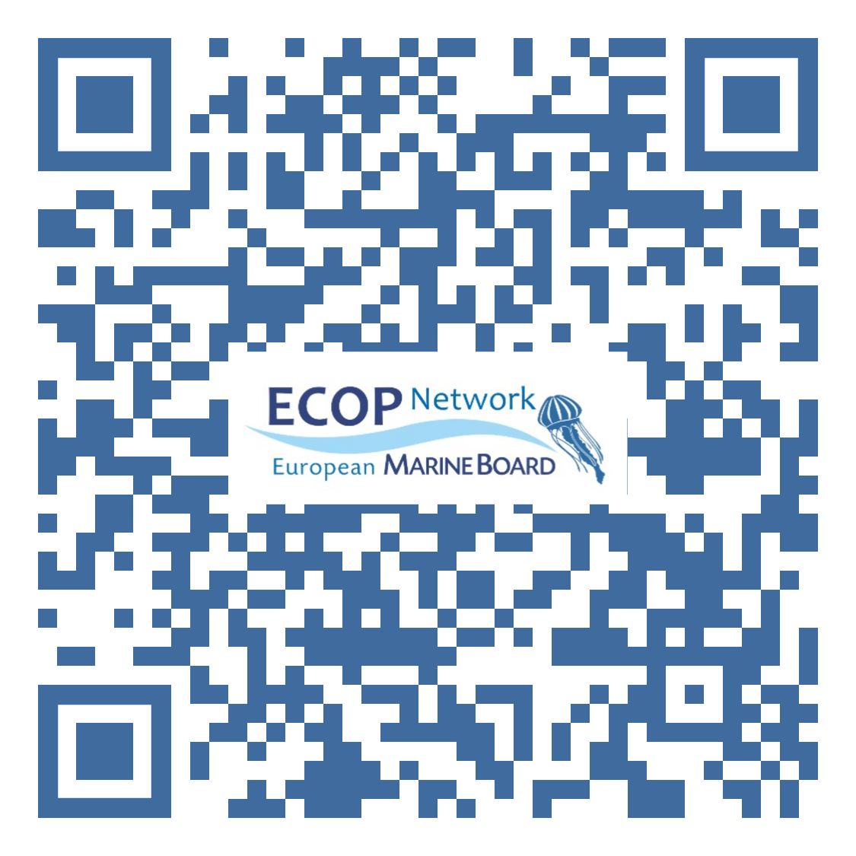
Join the Network
Register here
Webpage
Notes:
LinkedIN: https://www.linkedin.com/in/ecops-network-european-marine-board-48b163293/
Twitter: https://twitter.com/EcopsEmb
Webpage: https://www.marineboard.eu/about-emb-ecop-network Registration: https://docs.google.com/forms/d/e/1FAIpQLScWhpKrAbsxTu4_EeiA1LR128bXasOuwhrIkQZV4k4yilW-8w/viewform

